Slide 1

Big Data: Beyond Volume, Variety & Velocity
Getting More Value in Healthcare
Dr. Paul Terry CEO, PHEMI Health Systems
October 26, 2014
Notes:
Introducing PHEMI Research

Slide 2


BD2K
“Big Data to Knowledge”
NIH Initiative (http://bd2k.nih.gov)
$32M grants 2014, $656 over next 7 Years

Slide 3

Data as a Strategic Asset
Big Data is an immense Strategic Asset
“Digital Government: Build a 21st Century Platform to Better Serve The American People.
Harnessing Big Data – White House Strategy 23rd May 2012

Slide 4
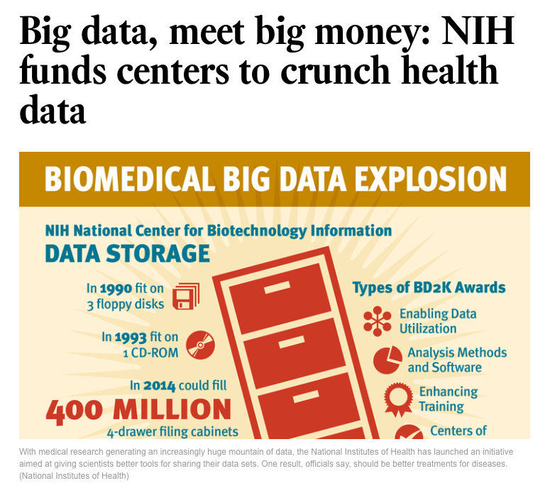

Slide 5
BD2K
“Big Data to Knowledge”
NIH Initiative (http://bd2k.nih.gov)
$32M grants 2014, $656 over next 7 Years

Slide 6
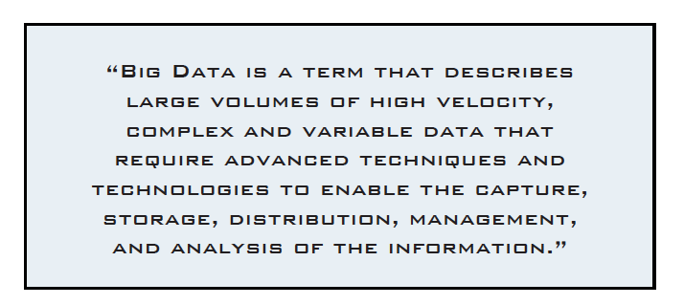
Big Data Definition

Slide 7
Big Data is like teenage sex:
Everyone talks about it, nobody really knows how to do it, everyone thinks that everyone else is doing it , so everyone claims that they are doing it ….

Slide 8


Slide 9
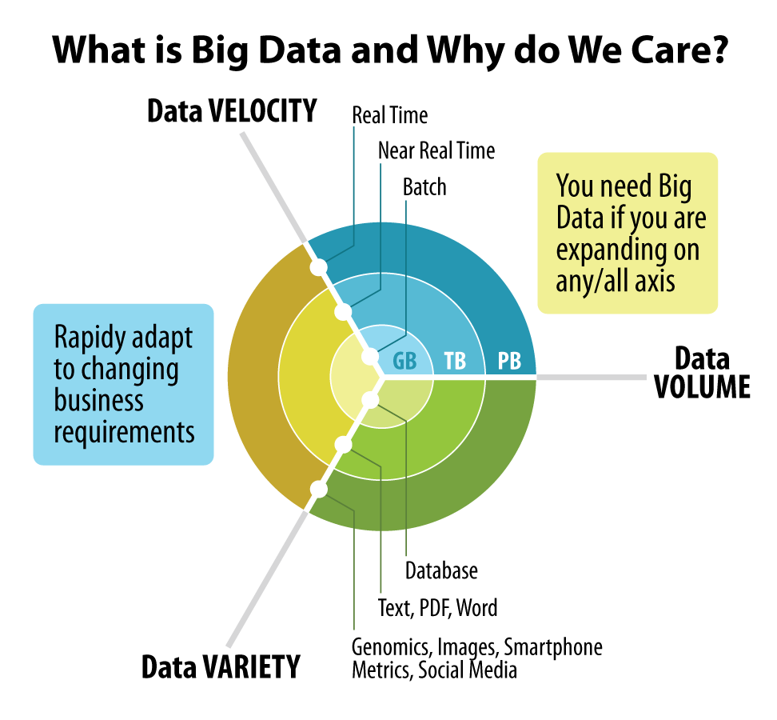
Why the Big Deal about Big Data?
70-80% of healthcare data is unstructured

Slide 10
Today’s Healthcare IT Challenges
Data Capture and Collection
Data Quality and Timeliness
Data Analytics and Reporting
Data Governance and Privacy Control
Data Rich / Information Poor
Notes:
We see enormous inefficiencies in unlocking patient data, aggregating it, ensuring quality and timeliness of information. Information is very often locked in unstructured and semistructured data, making it difficult to run reports and analytics. And governance/privacy controls are impeding knowledge.
With all these issues, it’s time for healthcare to adopt the best practices from other industries and bring those insights to healthcare and the public sector.

Slide 11
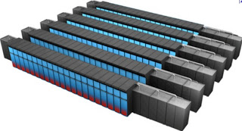
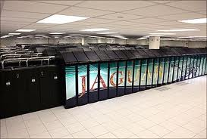
Cray

Slide 12
Big Data
We store an immense volume, variety and velocity of data
Why …
Compute is cheap and storage is free

Slide 13
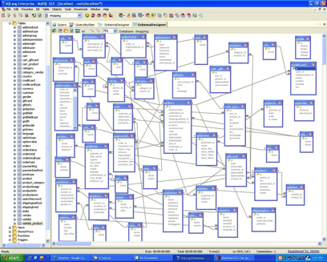
Schema

Slide 14

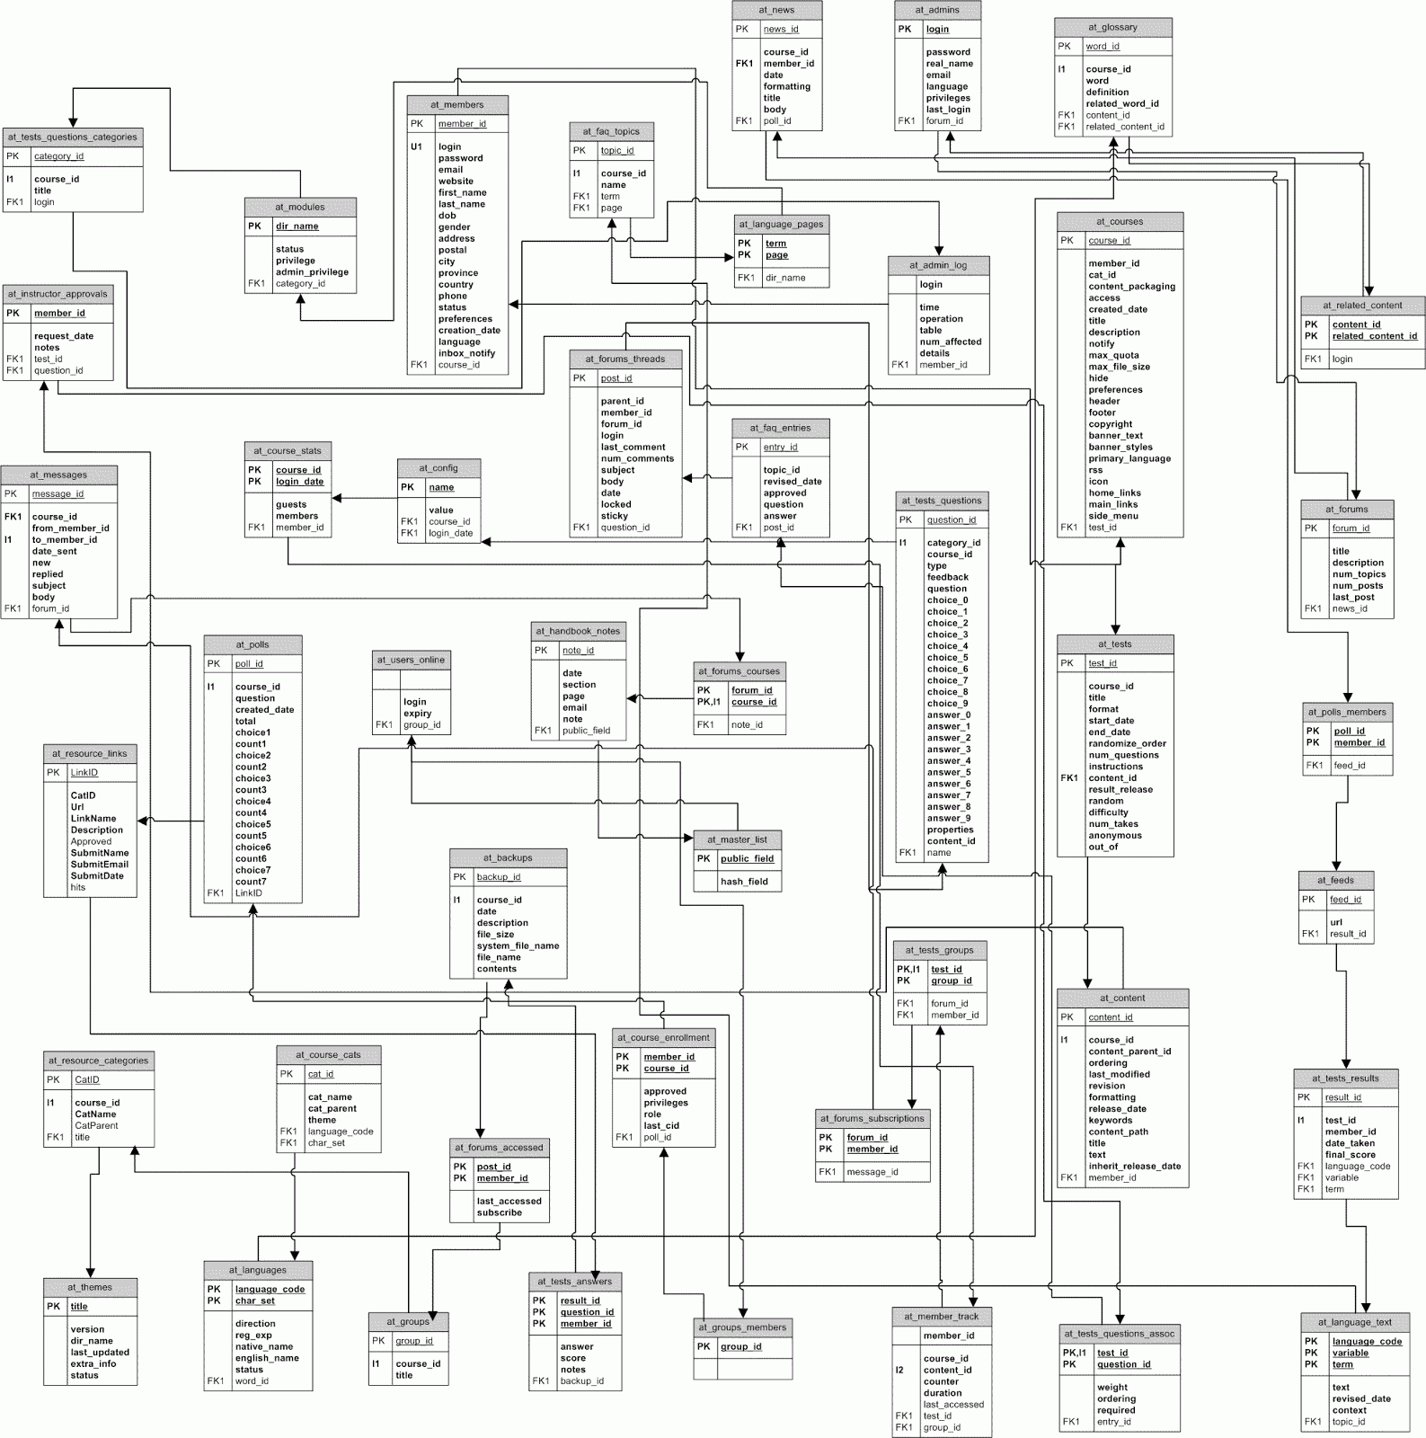
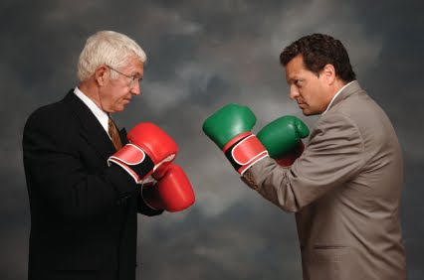

Healthcare
MANY Databases
Competing Standards/Semantics
Complex Schema
No Access

Slide 15
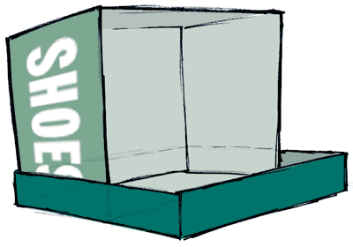

Big Data
Big Data is a ‘ShoeBox’ of everything
Notes:
There’s an enormous and fundamental shift in healthcare today. A shift from Document Management to Data Mining for the purposes of continuous improvement.
Spearheaded by the US “Health Information Technology for Economic and Clinical Health Act” (HITECH). Broken down into three stages of Meaningful Use.
Drive to data mining for continuous improvement in productivity and patient outcomes.
Stage 1: Data capture and sharing
Stage 2: Advance clinical processes
Stage 3: Improved outcomes

Slide 16
Data
Services
Data
not

Slide 17
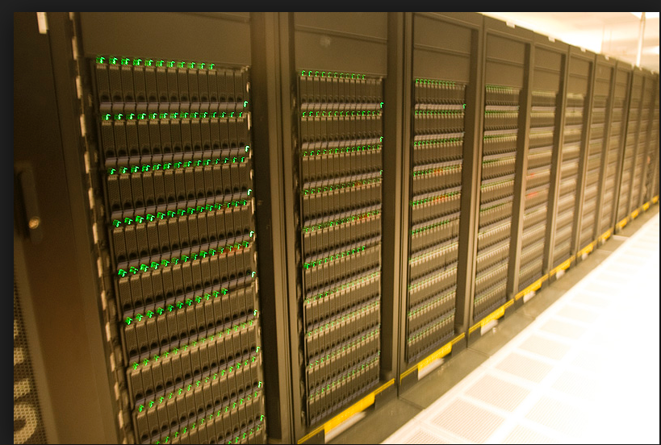
Storage Array

Slide 18
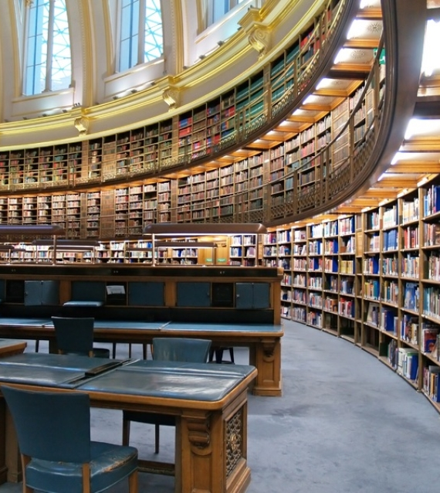
Lending Library
Consider
All papers
All patient info
Genotype
Phenotype
Notes:
At the heart of it, PHEMI Central is a Digital Asset Library. Like a library with different types of books, videos, CDs, and magazines, they all have different rules about who can check out information; who can view information and where it’s located in the library. When a new Digital Asset is added to the library, it is catalogued. These rules and asset descriptions are called “metadata” and are wrapped around the data in PHEMI Central.

Slide 19
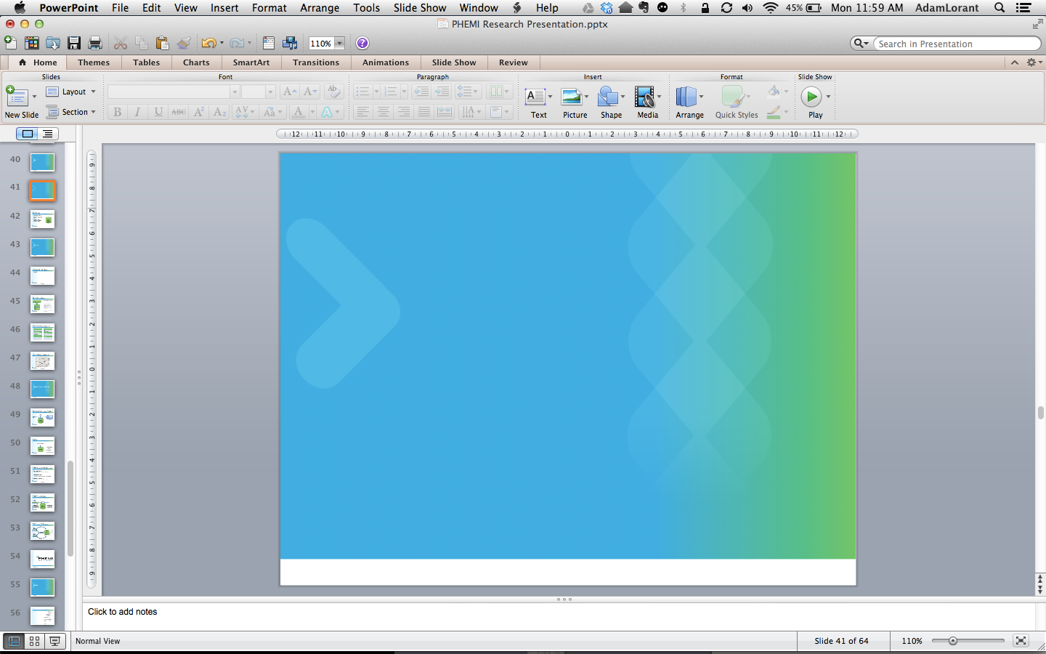
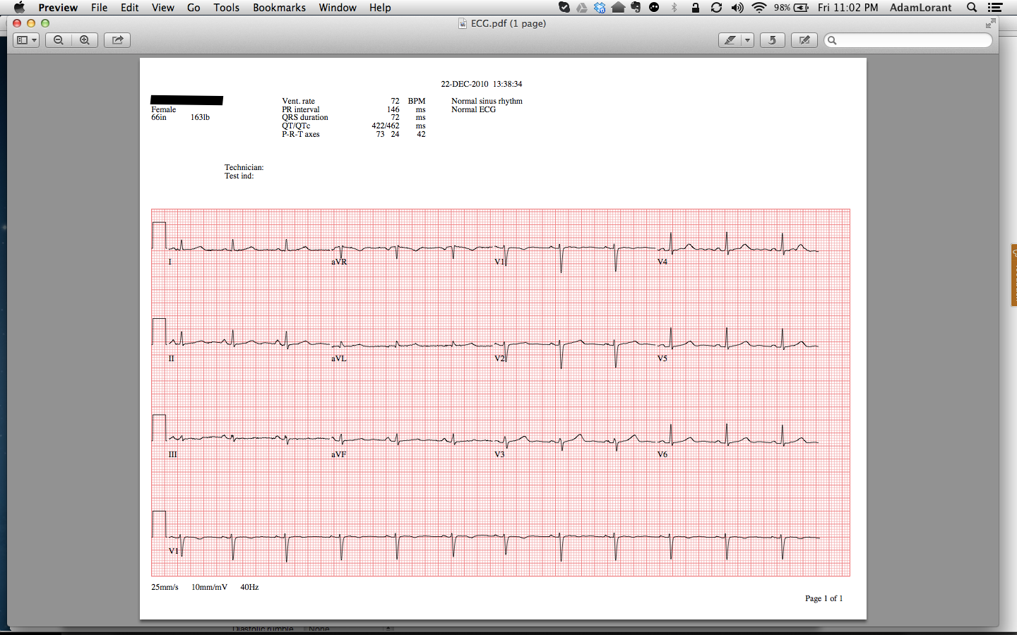
A Digital Asset
Digital Asset = Information + Metadata
Metadata
Timestamp of when it was imported
Location/Source imported from
Retention policy
Classification
Data type of asset
Version control information
Data agreements for the asset
Backup information
Etc.
Patient Information
Digital Asset
Metadata makes a digital asset valuable; it makes Big data possible in healthcare
Notes:
A Digital Asset looks like this. It consists of the data itself (for example an ECG, lab result, X-Ray or Consult Letter) plus metadata which are rules and asset descriptions about the data. The metadata defines the Governance Model for a dataset. It’s the metadata that makes the digital asset valuable, and makes BIG Data for health care possible. Without it, it would be difficult to find the information we were looking for.

Slide 20
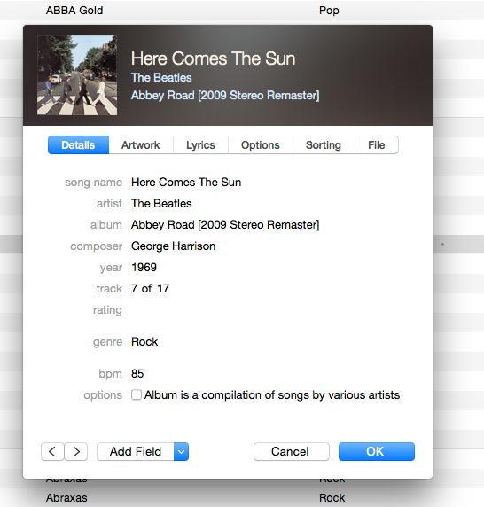

Slide 21
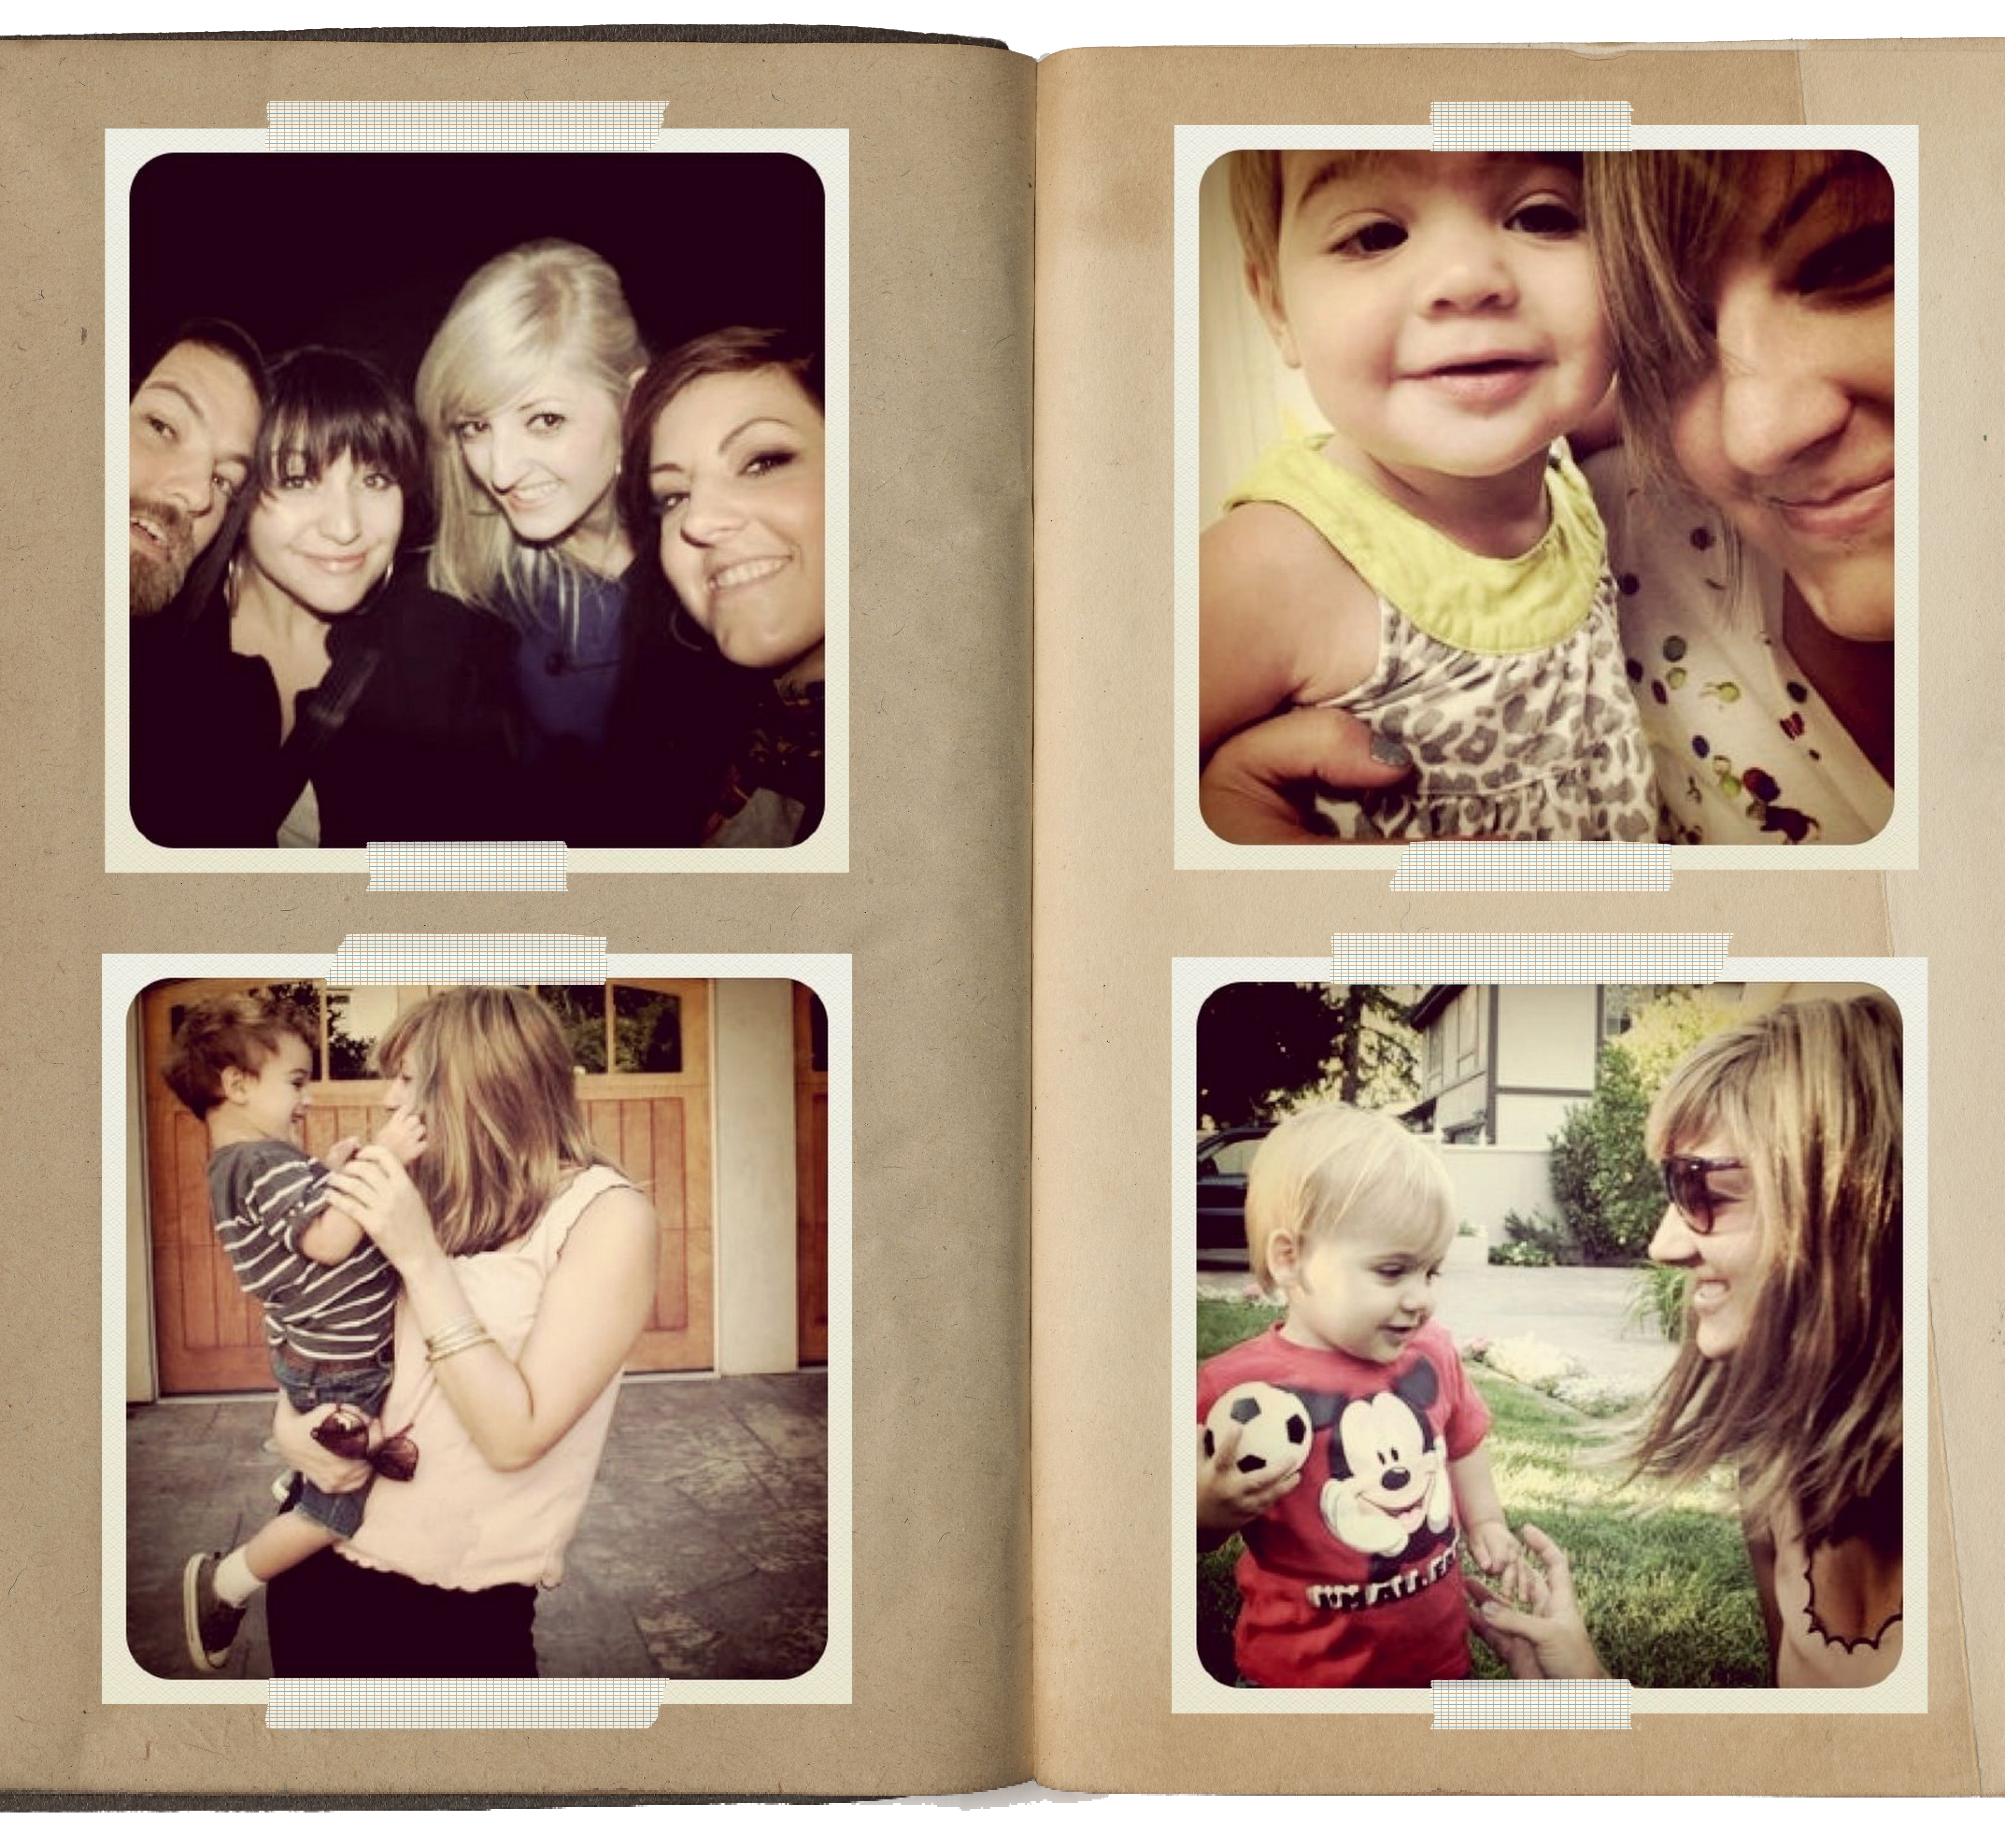
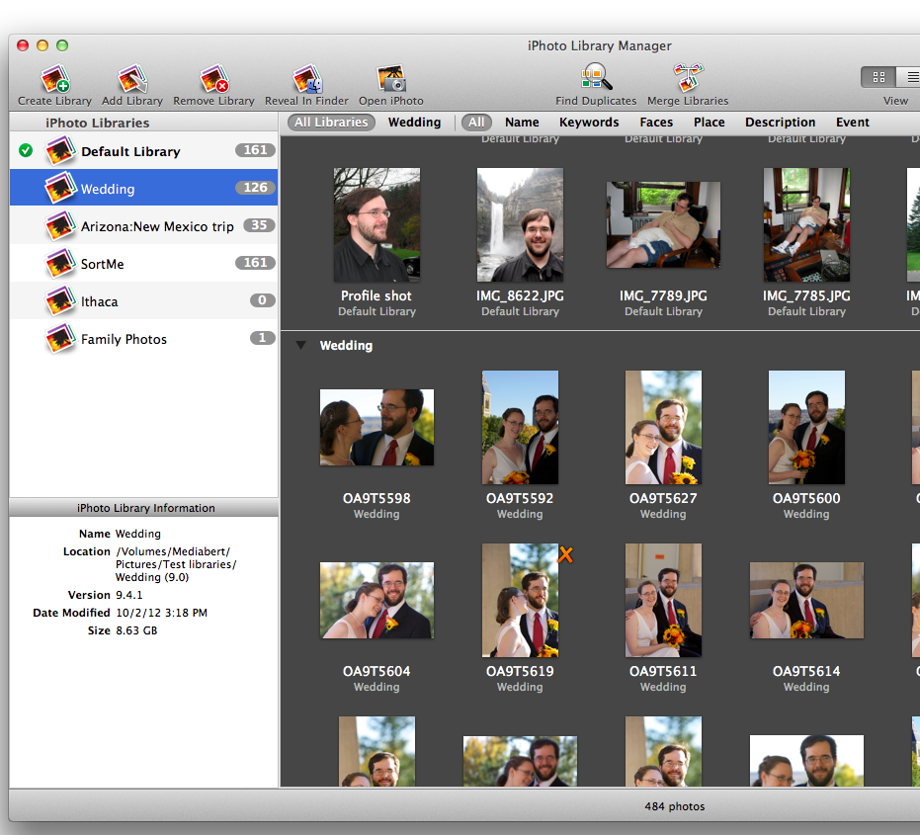
Photo Albums: Past and Present
Static, Rigid
Photo Albums
Versatile, Agile, Responsive
Virtual Photo Albums
Impose Structure
Compute Structure
Notes:
Ten years ago, we would take a roll of 36 pictures. Take the film to my local camera store. Wait a week for the film to be processed. Pick it up and put the pictures in an album. The photo in the upper left hand corner of page 3 in my Spring 1994 photo album was always a picture of me and my wife on honeymoon. That album is always on the top shelf second album from the left. That structure is static. It’s rigid. It’s imposed from the outset.
Contrast that with photography today. We take thousands of pictures a year. We store all the photos in a folder on a hard drive or on the Internet. Then we use software like Picasa or iPhoto to organize our pictures. We can create albums any time we like. A photo can be in many albums: Honeymoon 1994; Best of 1994; Best of the Best. Moreover, we can run face recognition software in the background. Each photo has a rich set of metadata (information about the photo) such as where it was taken, when it was taken, with which camera was it taken, who was in the photo, etc. It’s much more versatile and agile to compute structure rather than impose structure.

Slide 22
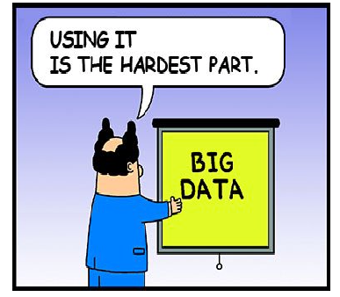

Slide 23
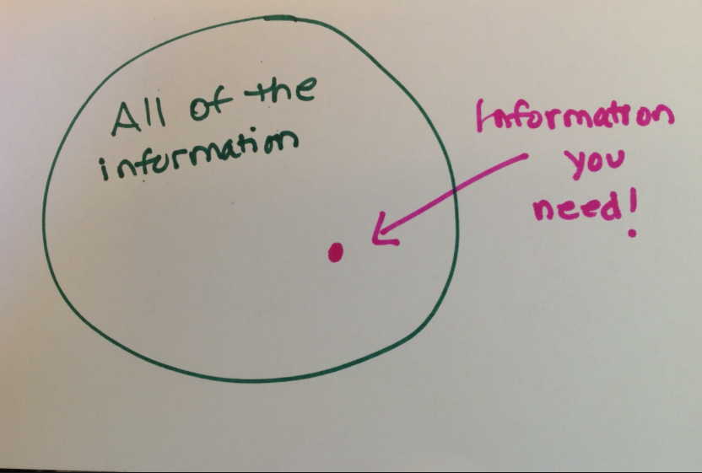

Slide 24
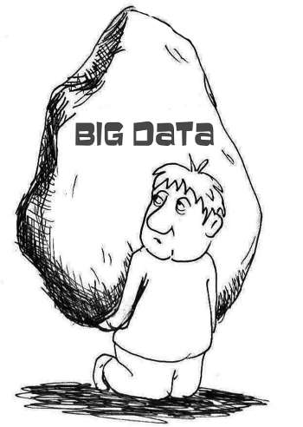
Big Data
We rely on ‘Computing’ to extract the facts, relationships indicators and pointers.
We can now store and analyse (continually)
more data than humans can read in their lifetime!

Slide 25
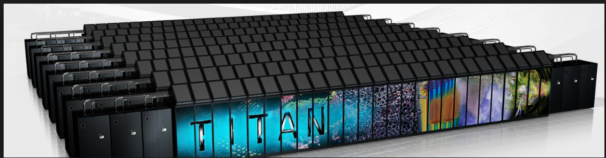
Compute Array

Slide 26


Small Supercomputer…
6 physical servers
18 processors, 108 cores
36 TB storage
3x redundant storage
Existing infrastructure
3
BIG
DATA
2
1
Faster Time to Insight
Notes:
When we talk of Google, Yahoo, Amazon and BIG Data, we tend to think of racks and racks of equipment. In fact, PHEMI Central can be quite small and grow. A dedicated PHEMI Central system is physically less that 2 feet tall (21”) and can store 3 million DNA sequences. Note that the physical server is shown for illustrative purposes only. PHEMI Central will typically operate on existing IT infrastructure.
Background:
DNA = 725 megabytes of data, since every base pair can be coded by 2 bits. Since individual genomes vary by less than 1% from each other, they can be losslessly compressed to roughly 4 megabytes.
16,500 DNA sequences (uncompressed) or 3 million DNA sequences (compressed)
6 x Dell PowerEdge C2100s.
2 Master Admin Servers = 2 x 6-core Xeon, 96GB RAM, 6 x 600 GB HDD.
1 Edge Node same config as above
3 Data (slave) nodes = 4 x 6-core Xeon, 24 GB RAM, 12 x 1TB HDD.

Slide 27



Big Data Model
PHEMI Clinical
Data Feeds
File Transfer
Forms
Gather
Store
Calculate
Report

Slide 28

Big Data facts
“Big Data is now affordable”
“Big Data can be deployed incrementally and iteratively”
“Big Data doesn’t have to be large amounts of data”
“Big Data challenges human perceptions”

Slide 29
Technology Underpinnings
Commodity hardware
Cheap compute – free storage
Big Data file systems e.g. Hadoop
MapReduce (parallel processing)
Scaleable analytics
Data centres, high speed interconnect
SAS models
Security, privacy, reliability

Slide 30
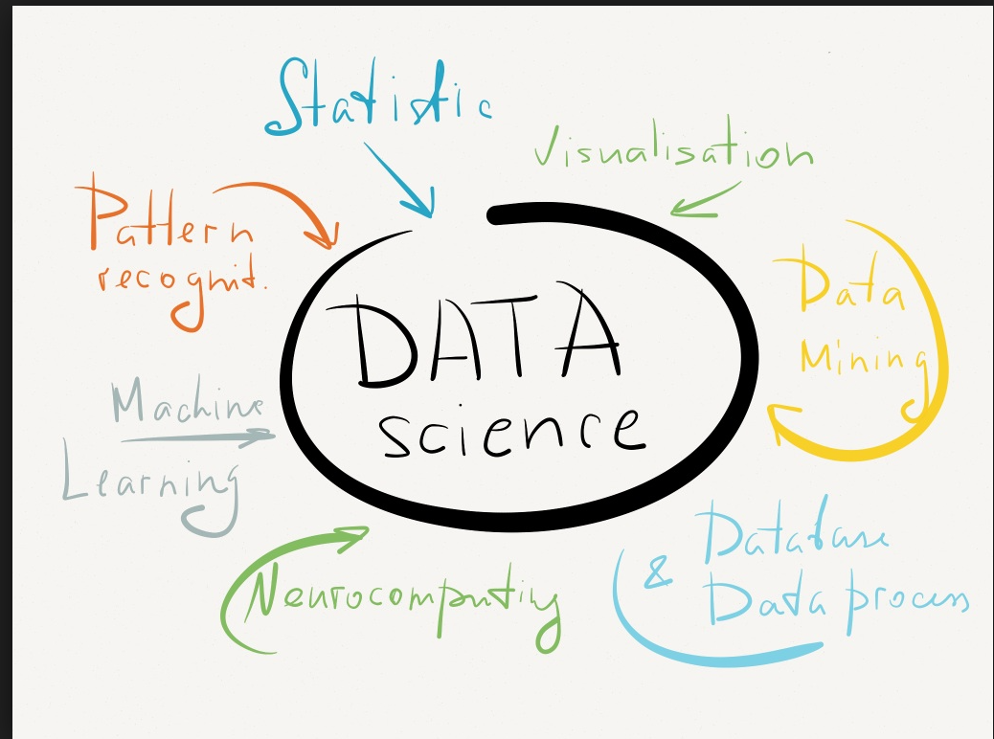
Data Science

Slide 31
Data → Information → Knowledge
Visualization -> Storytelling

Slide 32
Big Data will enable
Privacy by design
Correlation, not search
Unlocking the future value of data
Machines to do the heavy lifting
Curiosity based research
Federated data sharing
Reduced anonymization
Requirements are usually hindsight

Slide 33

Dr. Paul Terry President & CEO, PHEMI Health Systems
pterry@phemi.com

